Slide 1
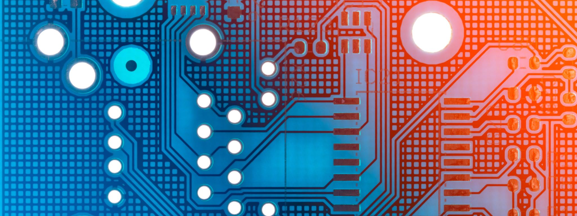
Introduction to Machine Learning
5752K11 Modul K
Digitalisierung und Künstliche Intelligenz

Slide 2
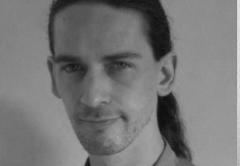

Getting to know us
Mag. Jan Senekowitsch
Dr. Joachim Krois

Slide 3
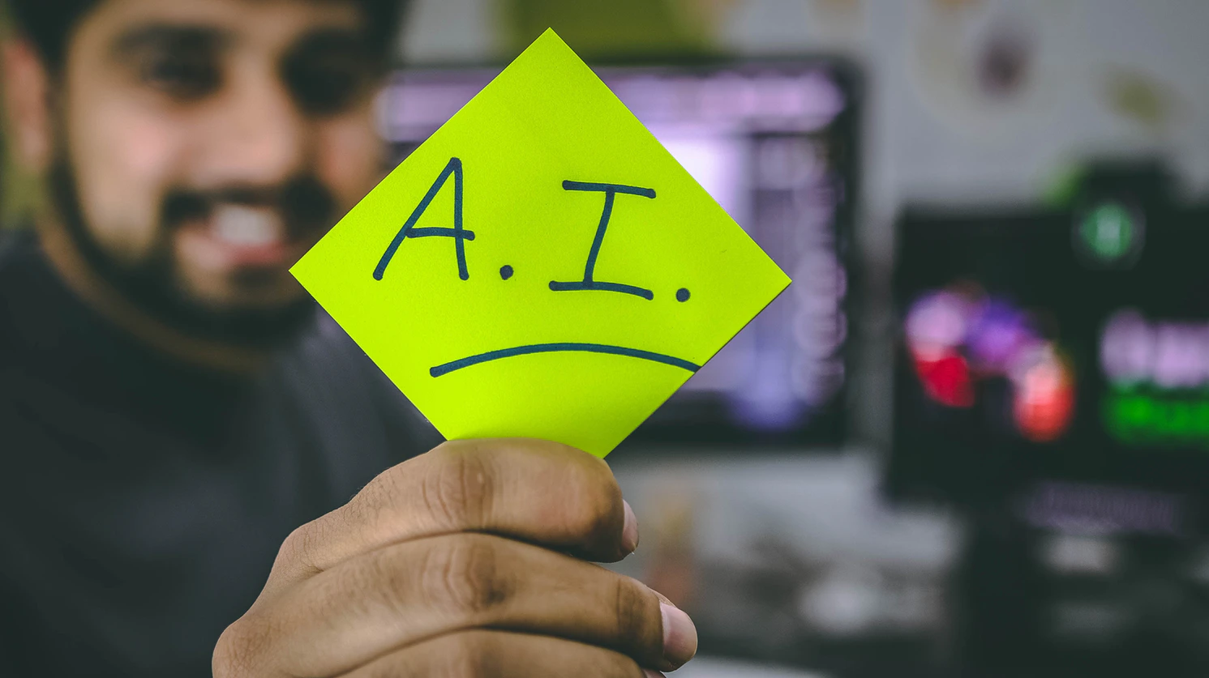
Getting to know you
Tell us about yourself.
Do you work on problems using machine learning or AI?
Do you use code to solve your problems?
What are your expectations for today?
~1-2 minutes

Slide 4
Let’s connect
Link FU-Box: …
Link Webex: …

Slide 5
Getting started
VPN Access to Cluster
Create a Kaggle account?

Slide 6
What is Machine Learning ?
What is Deep Learning ?

Slide 7
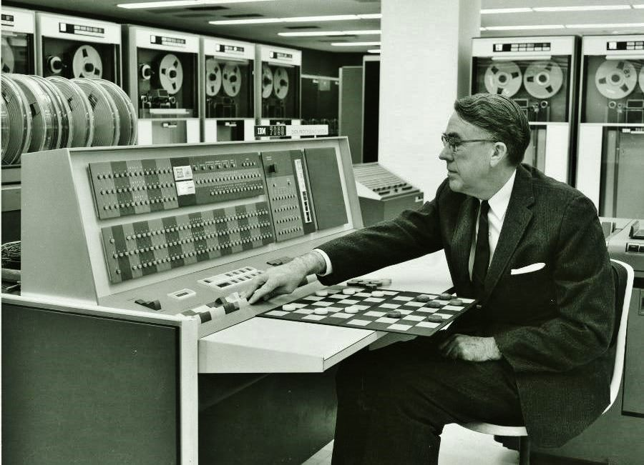
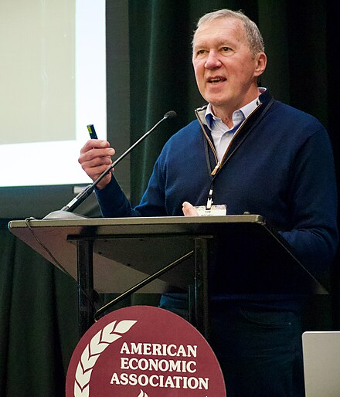
What is Machine Learning ?
Machine learning is the field of study that gives computers the ability to learn without being explicitly programmed.
- Arthur Samuel 1959
A computer program is said to learn from experience E with respect to some class of tasks T and performance measure P, if its performance at tasks in T, as measured by P, improves with experience E.
- Tom Mitchell 1997

Slide 8
Answer:
Machine learning is a subdomain of artificial intelligence, focused on finding suitable algorithms that enable models to learn from data and make more accurate predictions or decisions over time without human intervention.
What is Machine Learning ?

Slide 9
The History of AI:
What can we learn from the past?

Slide 10
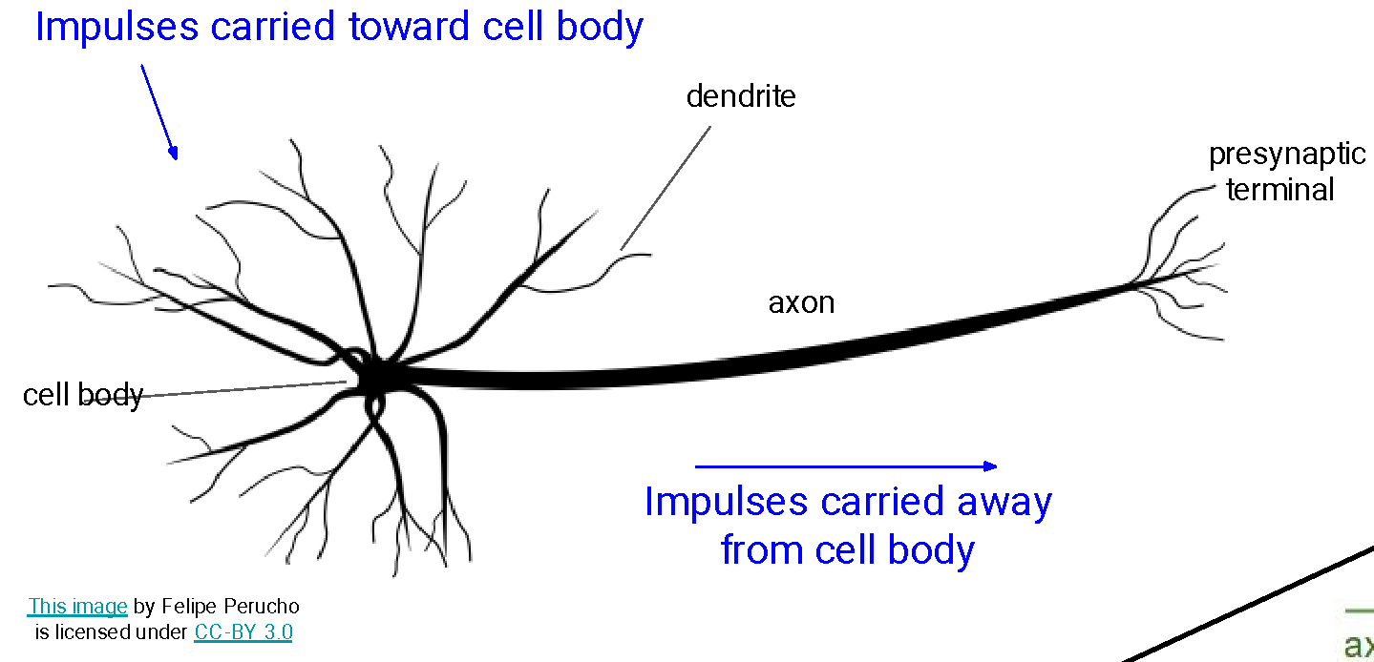
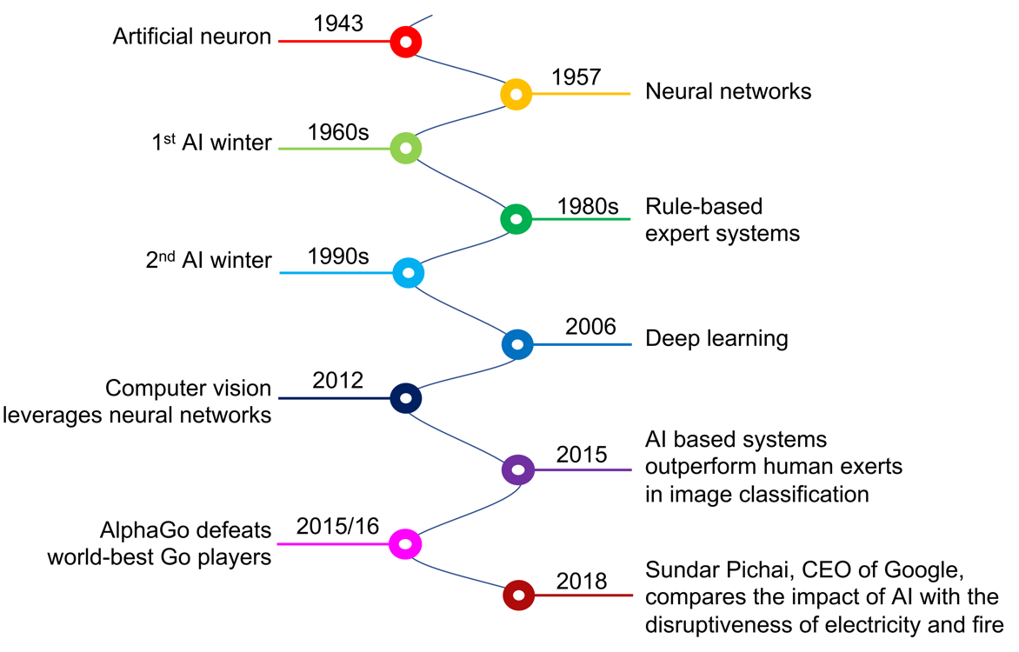
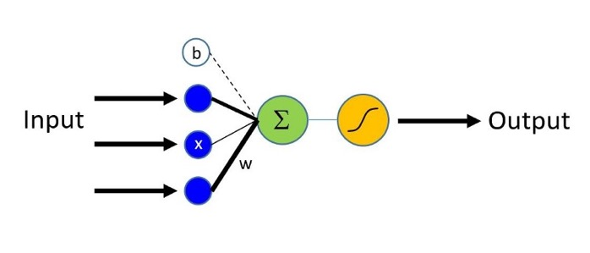
A brief history of AI
The neuron
The artificial neuron
McCulloch und Pitts (1943)
Source: Aaron Bornstein
Schwendicke et al. 2020

Slide 11
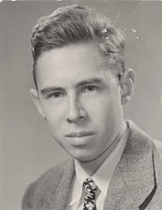
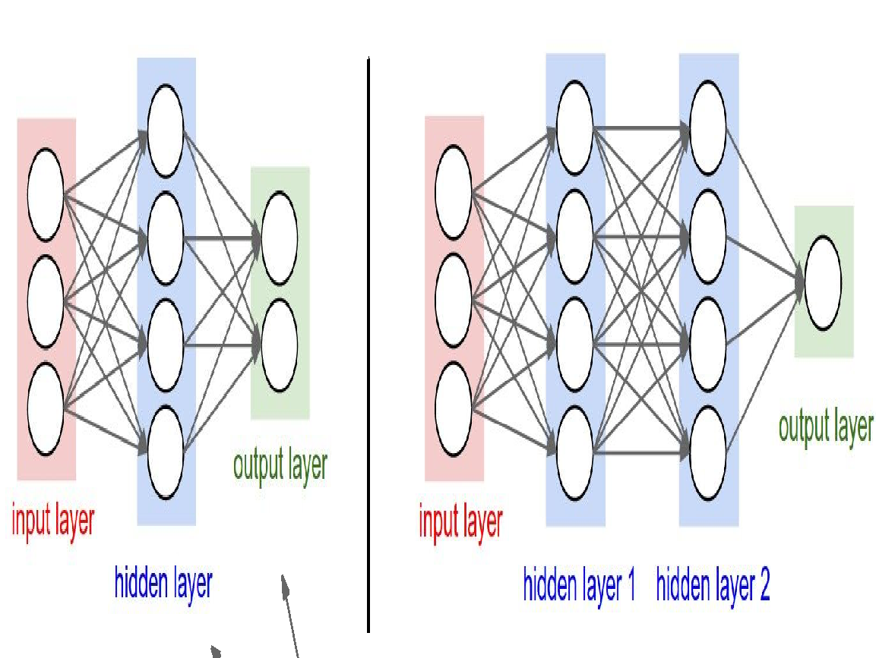
A brief history of AI
The Perceptron
Rosenblatt (1957)
Frank Rosenblatt
1920-1971
The neuron
Source: Aaron Bornstein
Schwendicke et al. 2020
Source: Stanford CS231n

Slide 12
A brief history of AI
The Perceptron
Rosenblatt (1957)
Frank Rosenblatt
1920-1971
“…the embryo of an electronic computer that [the Navy] expects will be able to walk, talk, see, write, reproduce itself and be conscious of its existence.” (New York Times, 1958)
The neuron
Source: Aaron Bornstein
Schwendicke et al. 2020

Slide 13

A brief history of AI
The 1st AI winter
The neuron
Computers were made in part to complete human tasks
Early on, generalized intelligence seemed possible
Turned out to be harder than expected
Source: Aaron Bornstein
Schwendicke et al. 2020

Slide 14

A brief history of AI
Rule-based expert systems
The neuron
Highly complex
Programmed by hundreds of engineers
Rigorous programming of many rules
Source: Aaron Bornstein
Schwendicke et al. 2020
Notes:
Rule based Systems were prevalent in the 1970´s and 1980´s
Were designed to mimick the knowledge of an expert
These systemes were designed by experts and mostly used procedural / imperative style programming and if … then rules
The use of expert systems subsided in the 1990´s and was replaced by machine learning methods (Random forest, SVM, neural networks) as expert systems lacked their ability to *learn* from new data

Slide 15
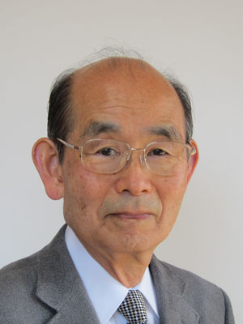
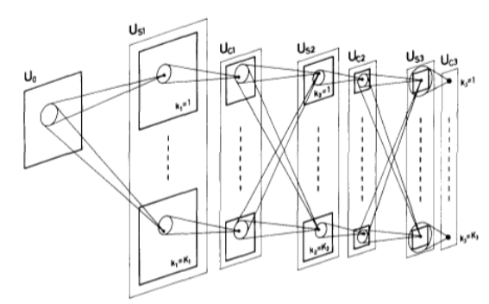
A brief history of AI
The Neocognitron
Fukushima (1979)
Kunihiko Fukushima
1936
The neuron
Source: Stanford CS217
Schwendicke et al. 2020

Slide 16
A brief history of AI
The 2nd AI winter
The neuron
Classification of images is hard to program rule-based
Snow
Winter
deep snow skiing
Tree
….
Source: Aaron Bornstein
Schwendicke et al. 2020

Slide 17
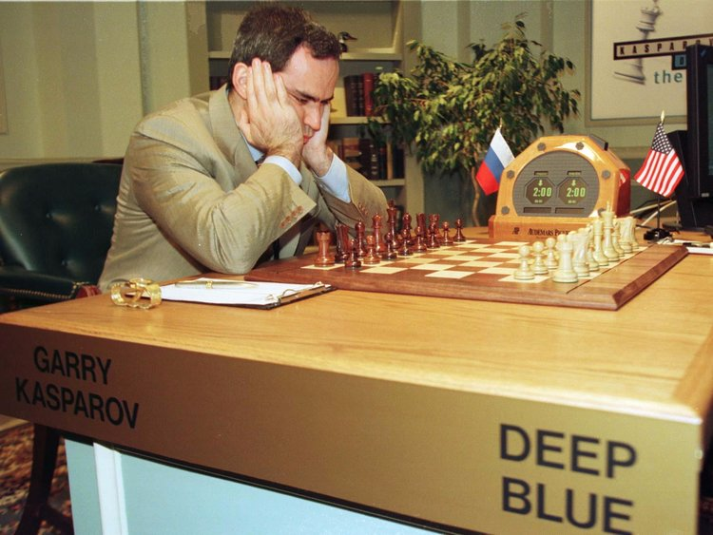
A brief history of AI
In 1996 IBM's Deep Blue algorithm defeated Garry Kasparov at chess.
The neuron
Source: Aaron Bornstein
Schwendicke et al. 2020

Slide 18
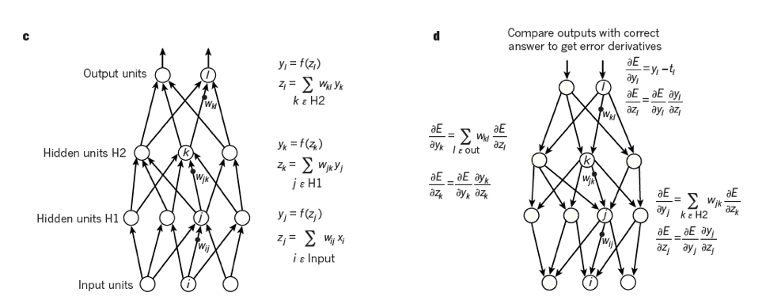
A brief history of AI
Deep learning
The neuron
New algorithms (backpropagation)
Exponential growth in available data
Computing power (GPUs)
Source: Aaron Bornstein
Schwendicke et al. 2020

Slide 19
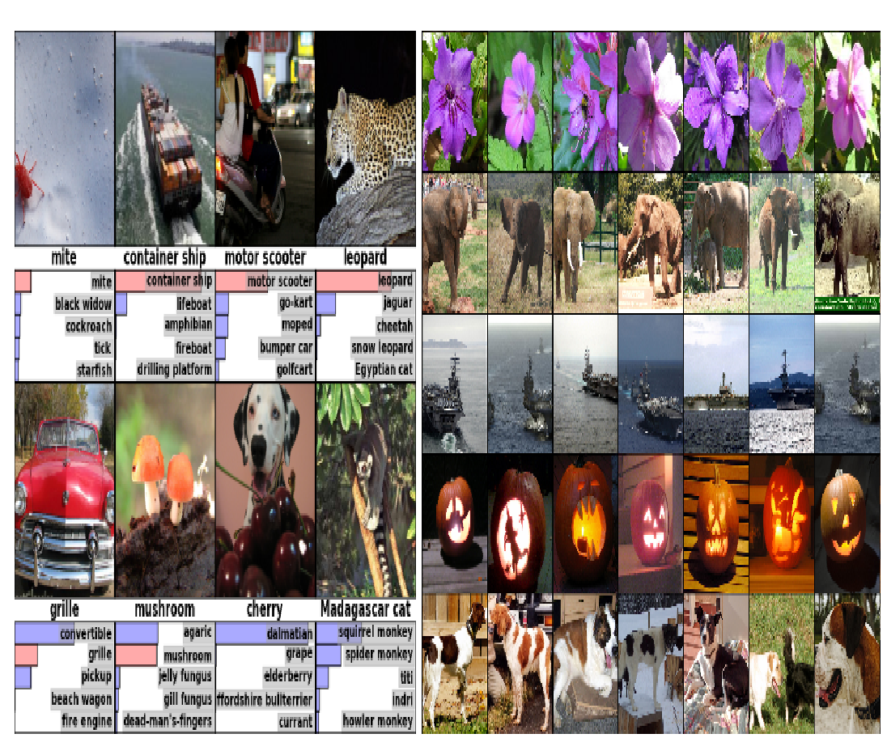

A brief history of AI
Computer vision
ImageNet Large Scale Visual Recognition Challenge (ILSVRC)
The neuron
Source: Aaron Bornstein
Schwendicke et al. 2020
Krizhevsky et al 2012

Slide 20
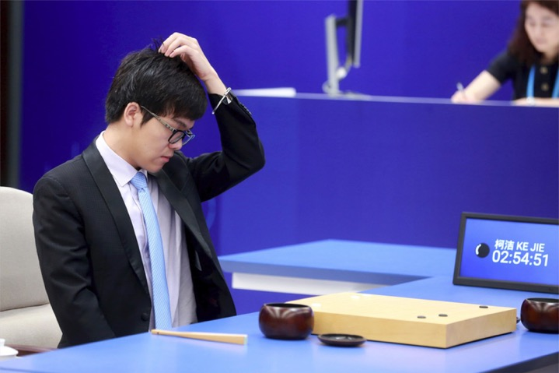
A brief history of AI
AlphaGo crushes the world’s best Go players
The neuron
Go is considered an extremely complex game; the win by AlphaGo is a milestone in history of machine learning.
Source: Aaron Bornstein
Schwendicke et al. 2020

Slide 21
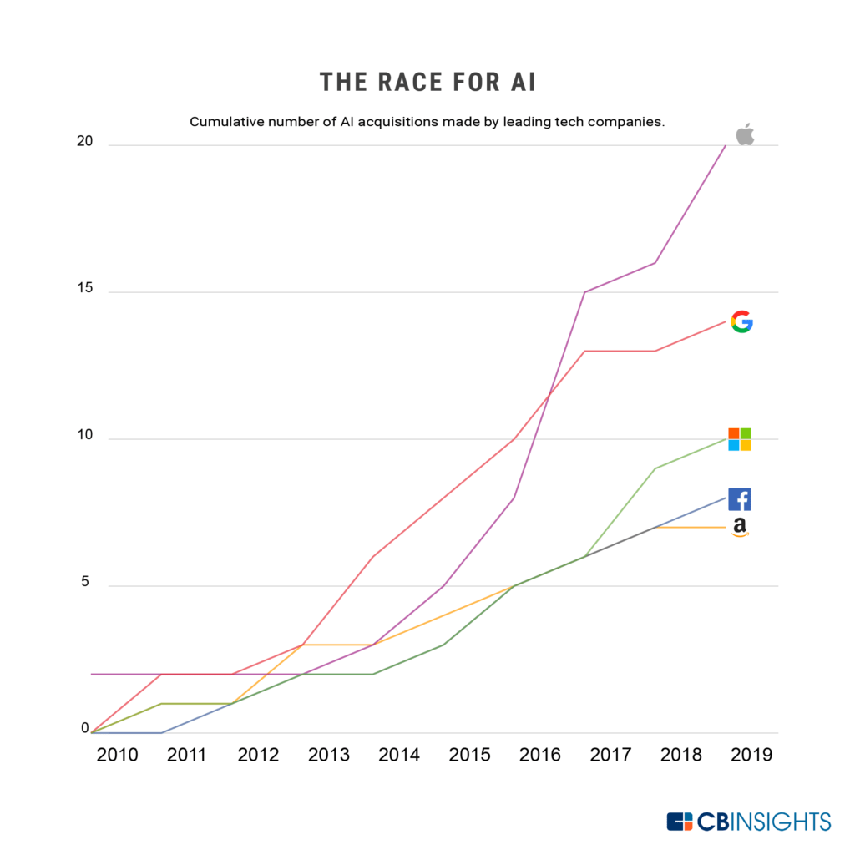
A brief history of AI
The neuron
Source: Aaron Bornstein
Schwendicke et al. 2020

Slide 22

AI spring ???

Slide 23
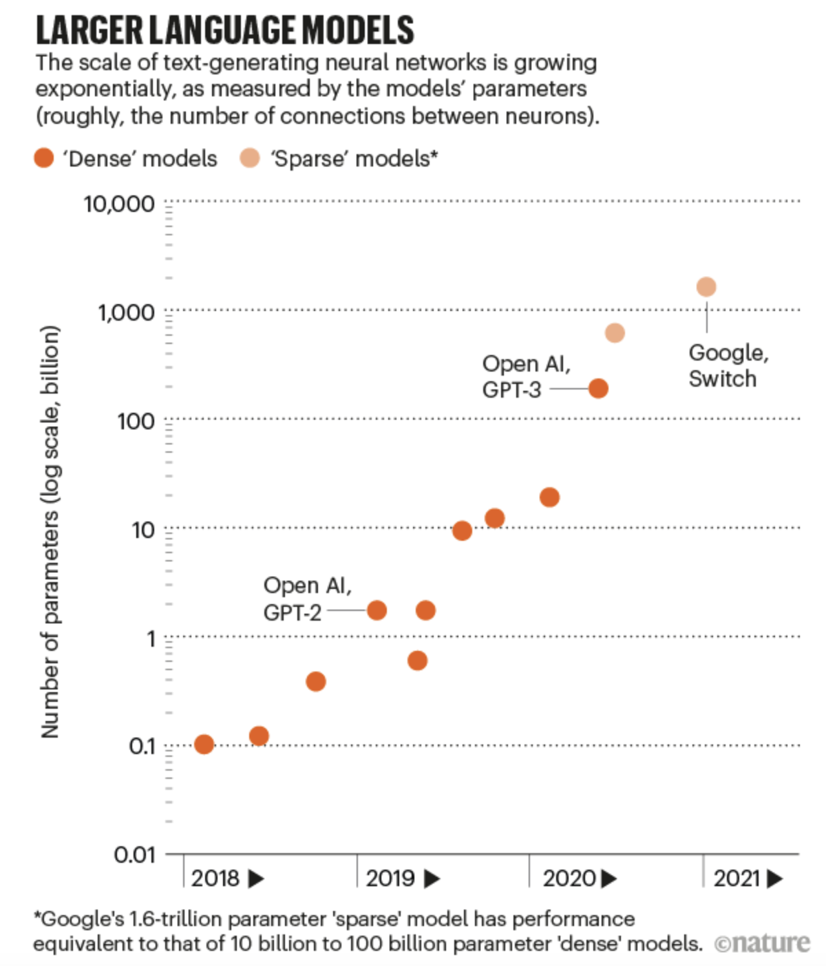
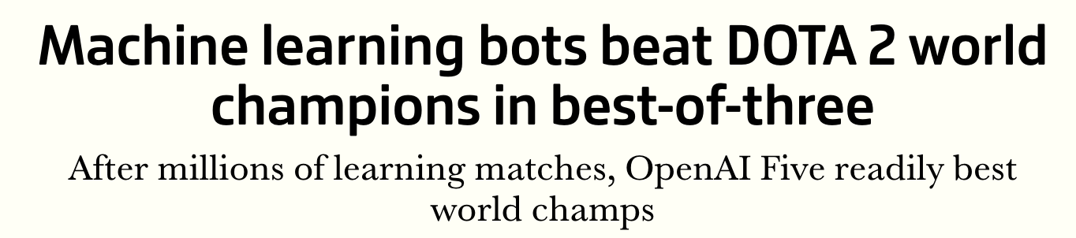
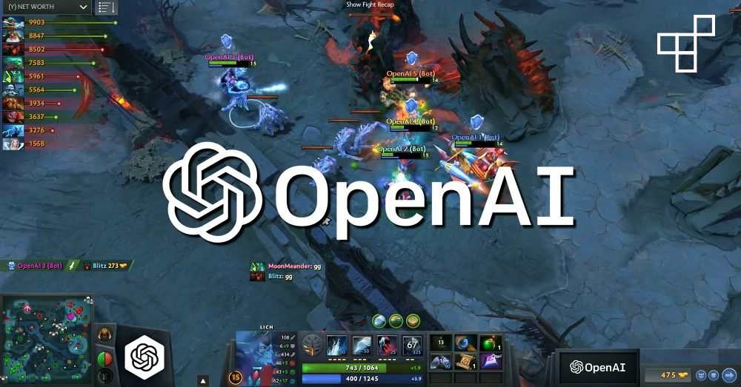
A brief history of AI – What happened since 2018
https://www.youtube.com/watch?v=tF4DML7FIWk
In 2019 OpenAI's algorithm, Five, defeats the best DOTA 2 team in the world
Notes:
https://www.theguardian.com/commentisfree/2020/sep/08/robot-wrote-this-article-gpt-3
https://www.instapainting.com/

Slide 24
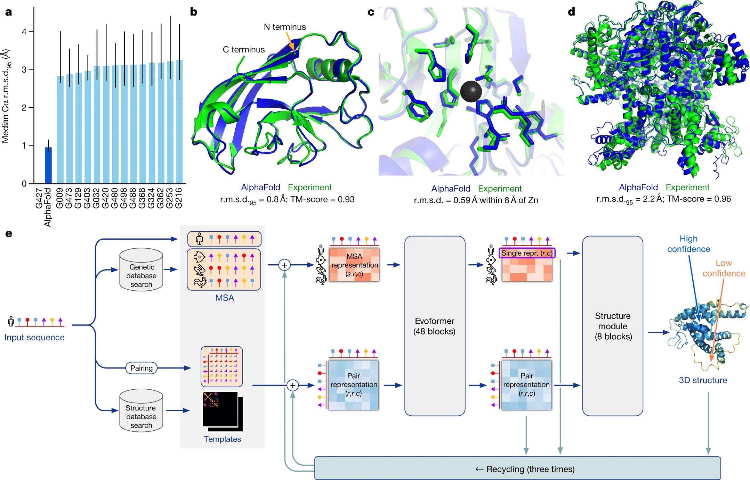
A brief history of AI – What happened since 2018
https://www.youtube.com/watch?v=tF4DML7FIWk
In November 2020, DeepMind's AlphaFold algorithm has solved the riddle of how proteins acquire their three-dimensional shape from a sequence of genetic instructions.
Source: Nature
Notes:
https://www.theguardian.com/commentisfree/2020/sep/08/robot-wrote-this-article-gpt-3
https://www.instapainting.com/

Slide 25
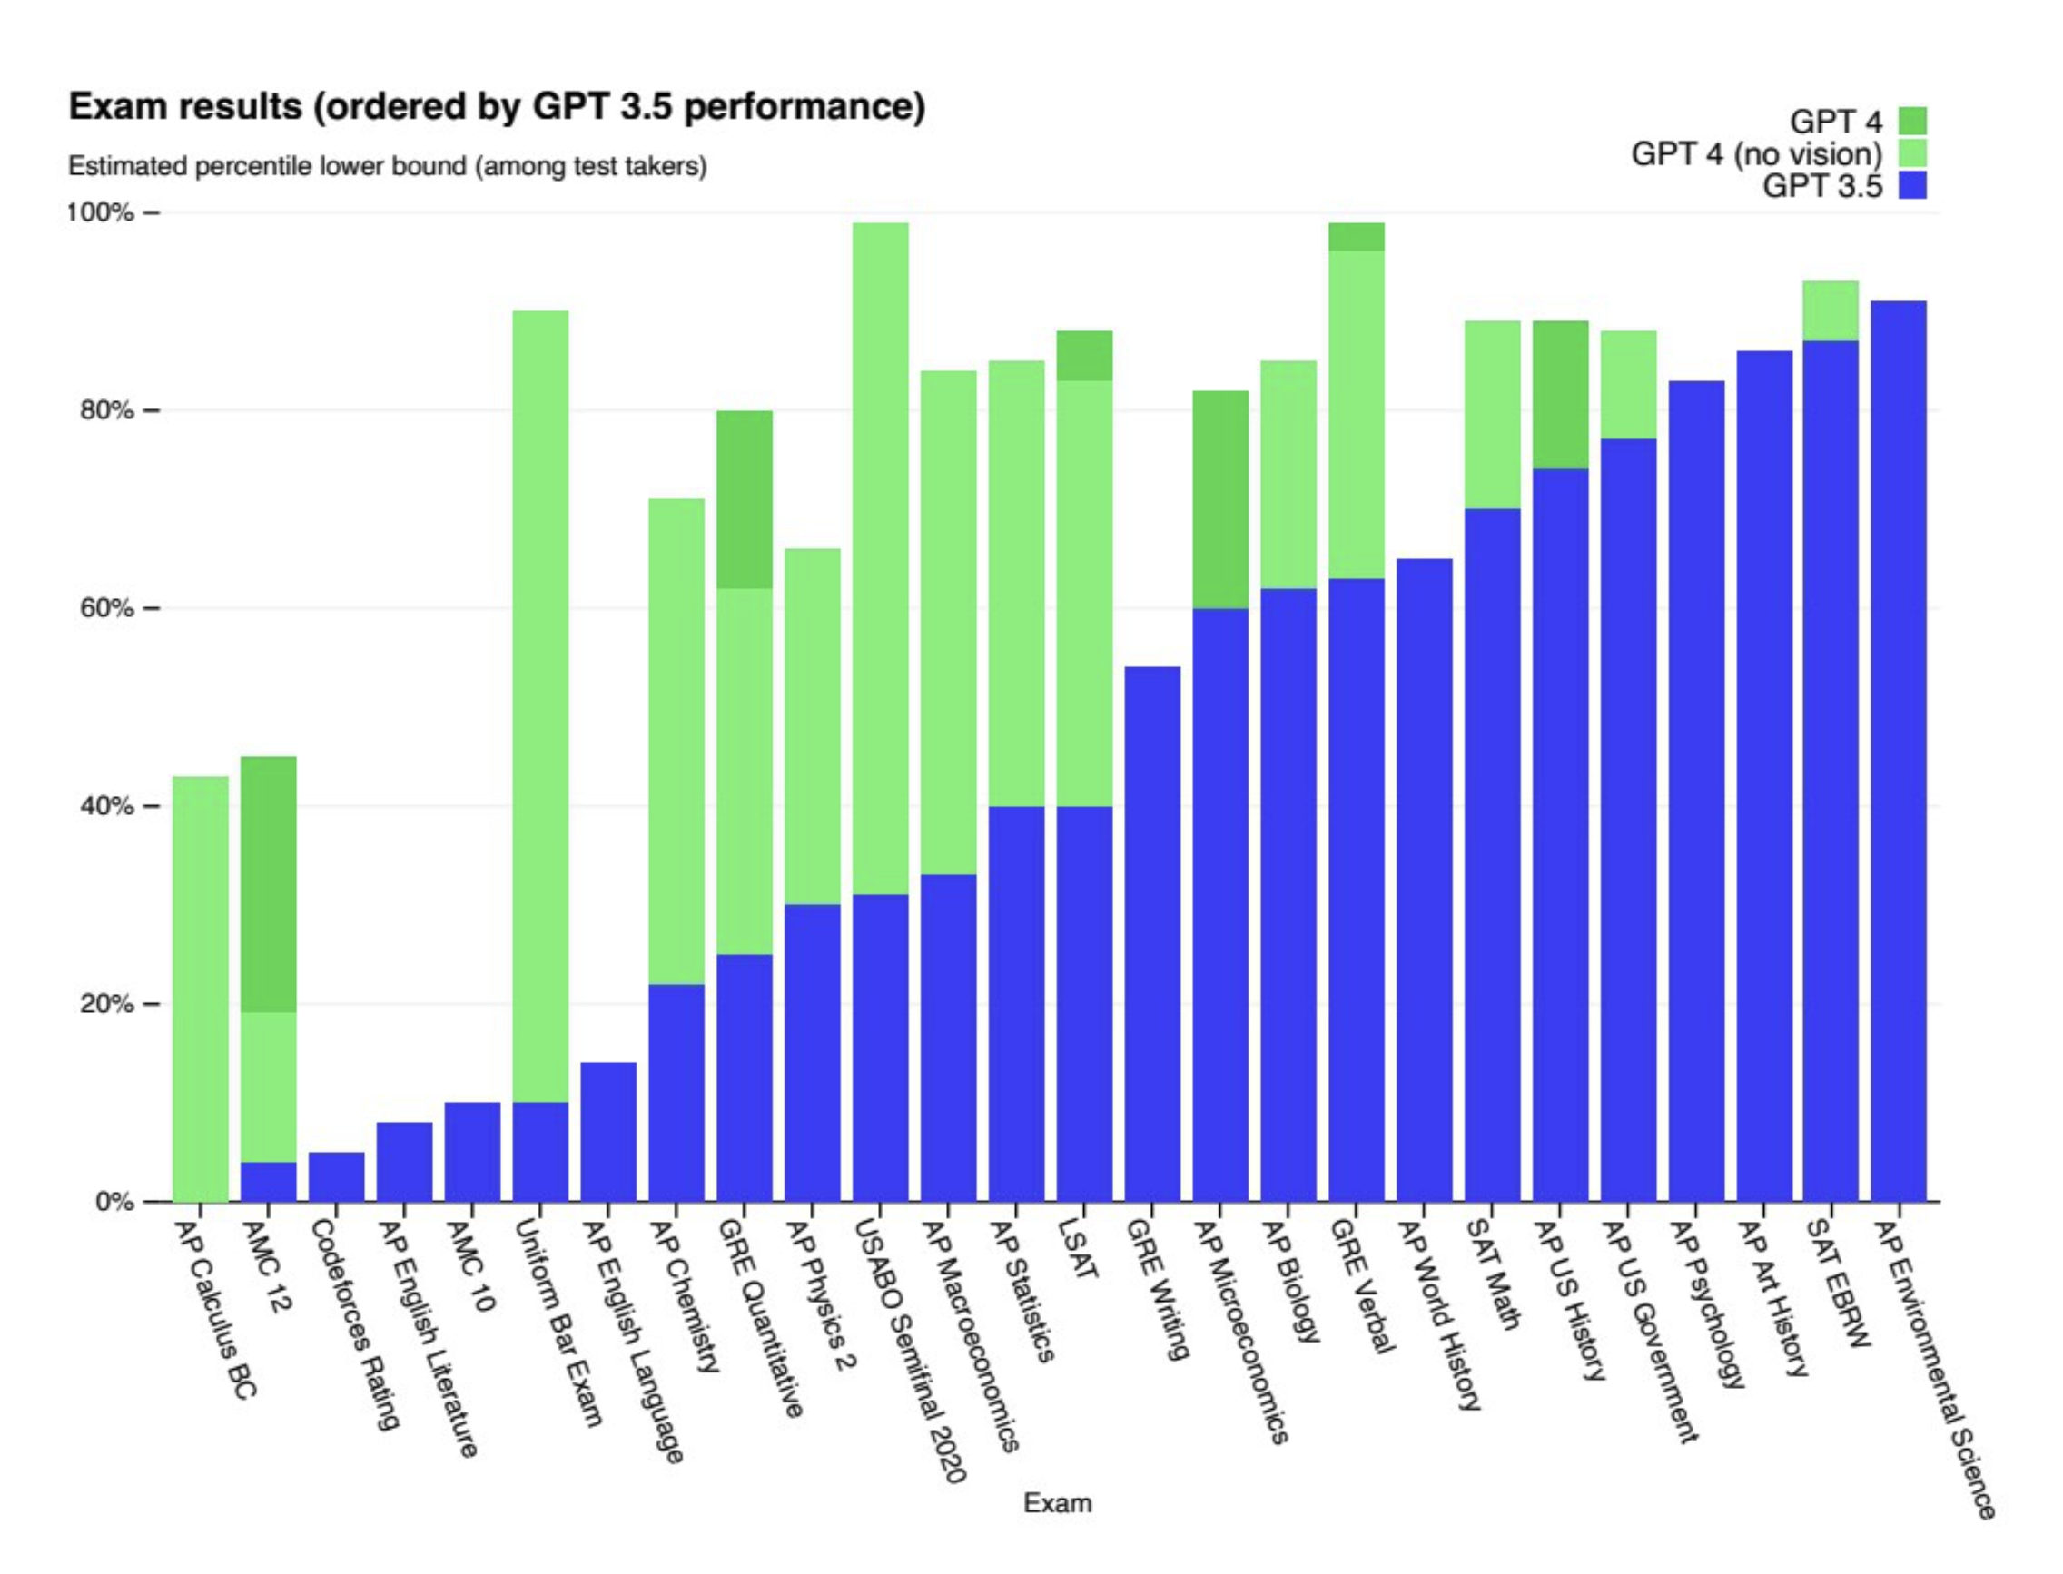
A brief history of AI – What happened since 2018
https://www.youtube.com/watch?v=tF4DML7FIWk
2023
GPT-4 passes several tests (including at university level)
examination procedures need to be rethought
Notes:
https://www.theguardian.com/commentisfree/2020/sep/08/robot-wrote-this-article-gpt-3
https://www.instapainting.com/

Slide 26
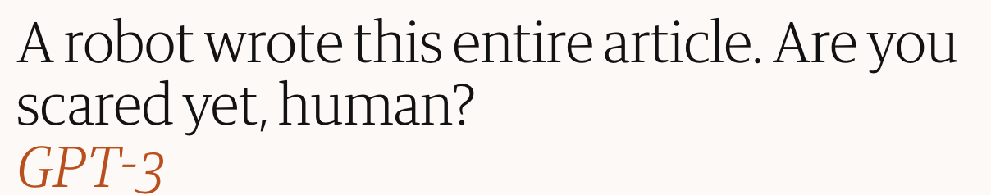

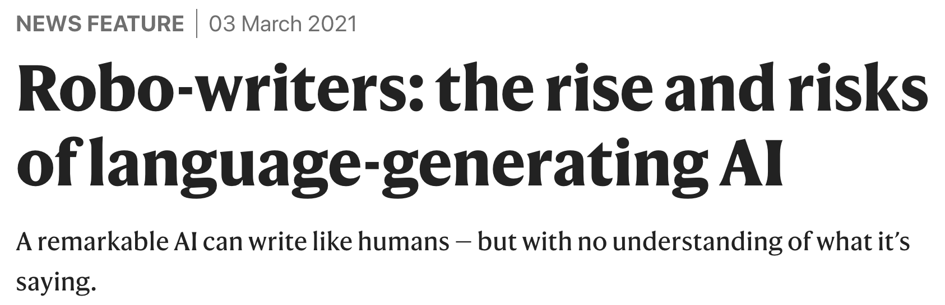
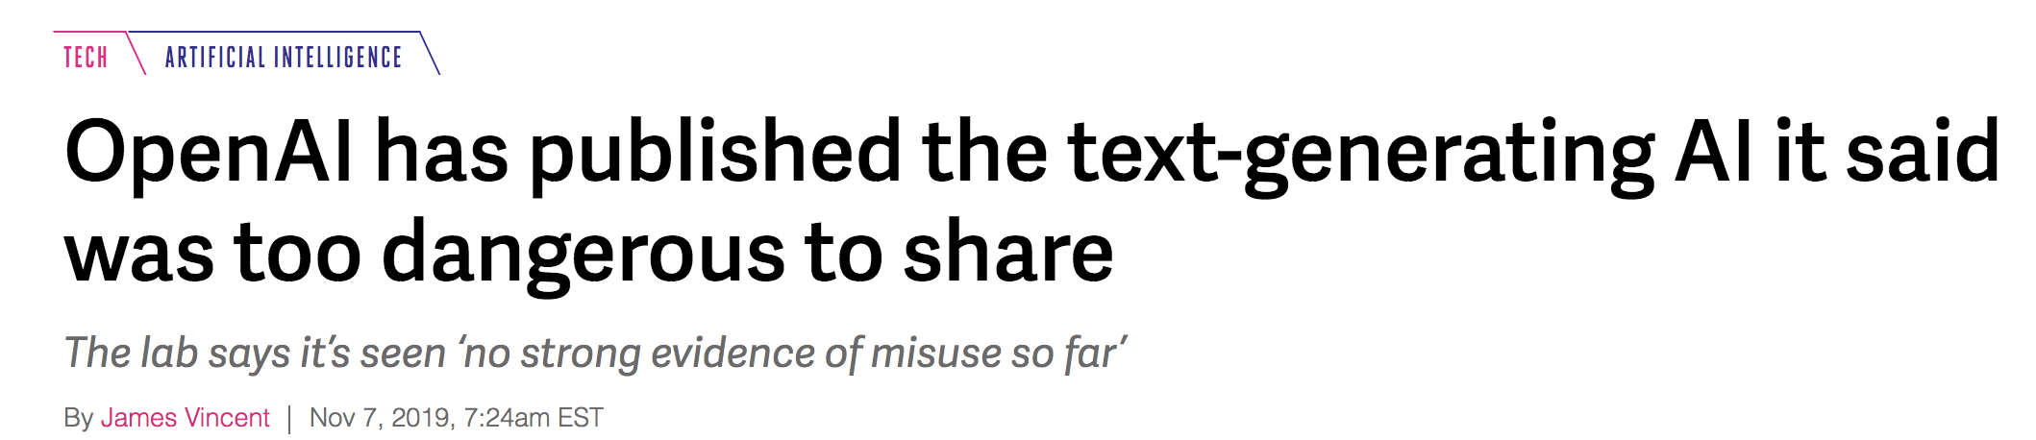
A brief history of AI – What happened since 2018
https://www.youtube.com/watch?v=tF4DML7FIWk
Notes:
https://www.theguardian.com/commentisfree/2020/sep/08/robot-wrote-this-article-gpt-3
https://www.instapainting.com/

Slide 27
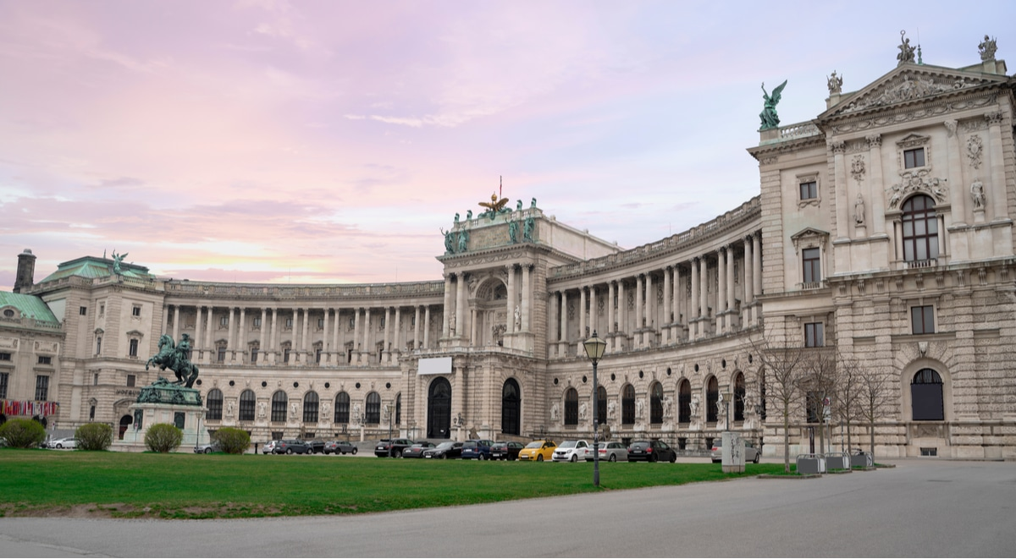
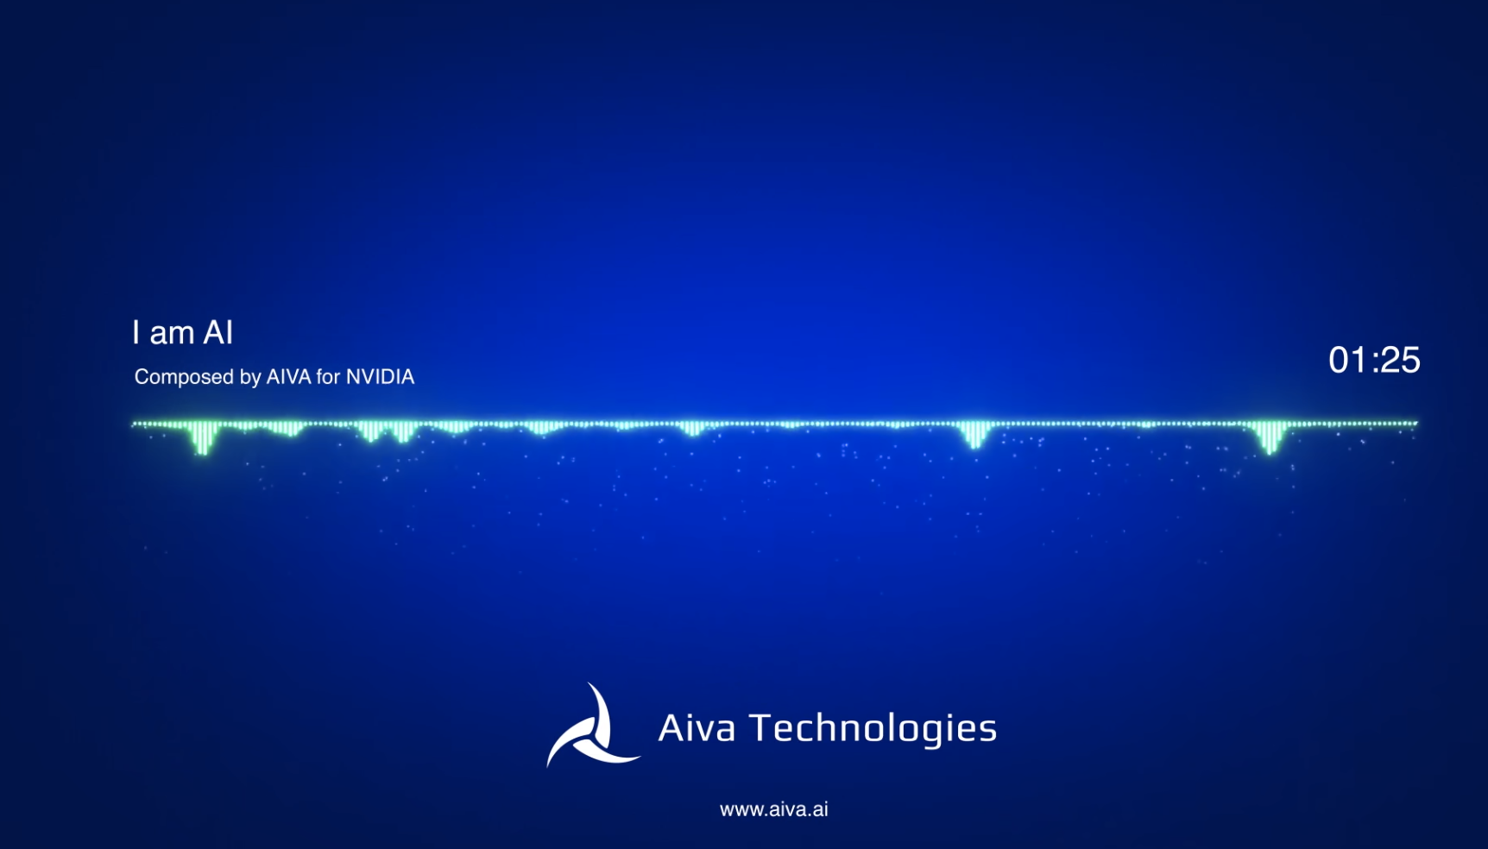
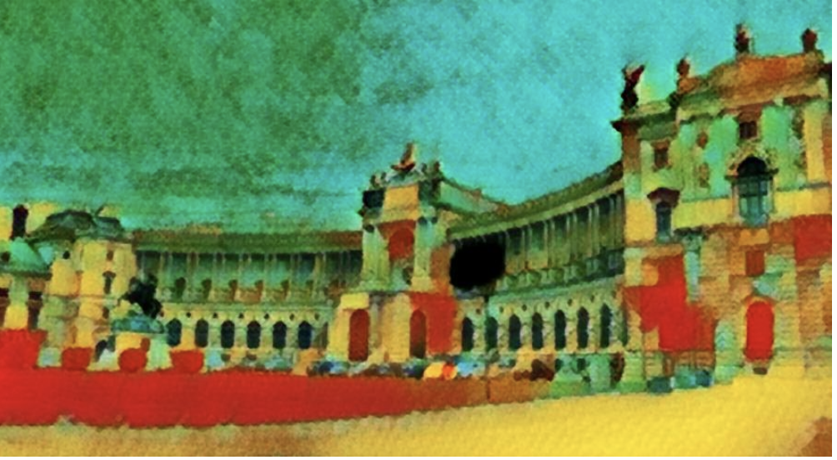
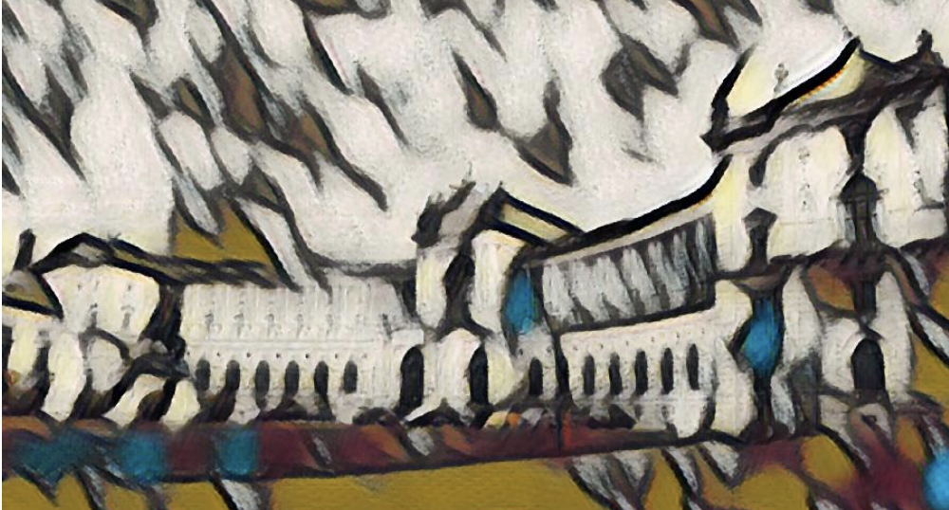
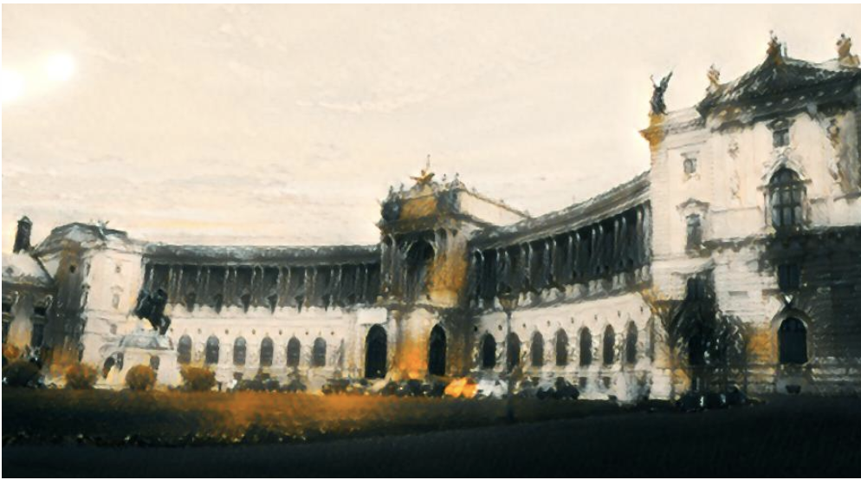
A brief history of AI – What happened since 2018
https://www.youtube.com/watch?v=tF4DML7FIWk
Art, it’s not just a Homo sapiens thing anymore!
https://www.instapainting.com/
https://www.aiva.ai/
Notes:
https://www.theguardian.com/commentisfree/2020/sep/08/robot-wrote-this-article-gpt-3

Slide 28
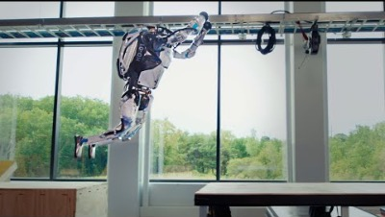
A brief history of AI – What happened since 2018
https://www.bostondynamics.com/
Notes:
https://www.theguardian.com/commentisfree/2020/sep/08/robot-wrote-this-article-gpt-3

Slide 29
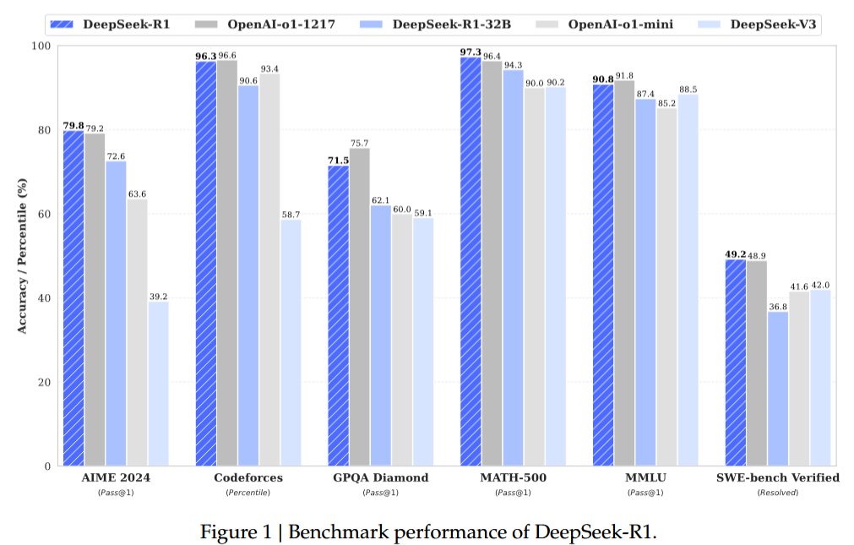
A brief history of AI – What happened since 2018
In January 2025 DeepSeek is released
DeepSeek surpasses several other large language models from OpenAI and Meta despite of considerably lower budget
Source: arxiv
Notes:
https://www.theguardian.com/commentisfree/2020/sep/08/robot-wrote-this-article-gpt-3

Slide 30
When do we need machine learning ?

Slide 31

We need to differentiate between two main classes of problems:
1) Problems, which have a definite answer.
(apriori knowledge)
2) Problems, that do not have a clear, predefined solution, thus requiring the computer to learn from data.
(aposteriori knowledge)
When do we need machine learning ?

Slide 32
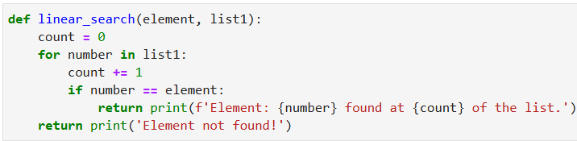
As an example for problems of type 1 consider e.g. the linear search algorithm:
When do we need machine learning ?

Slide 33
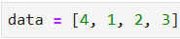
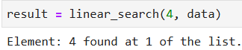
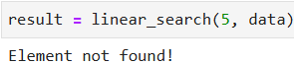
When do we need machine learning ?

Slide 34


As an example for problems of type 2 consider e.g.
a spam filter:
When do we need machine learning ?

Slide 35
As an example for problems of type 2 consider e.g.
a spam filter:
The filter needs to differentiate emails from spam.
(Classification)
The filter needs to react to new spam content.
(Adaptility)
When do we need machine learning ?

Slide 36
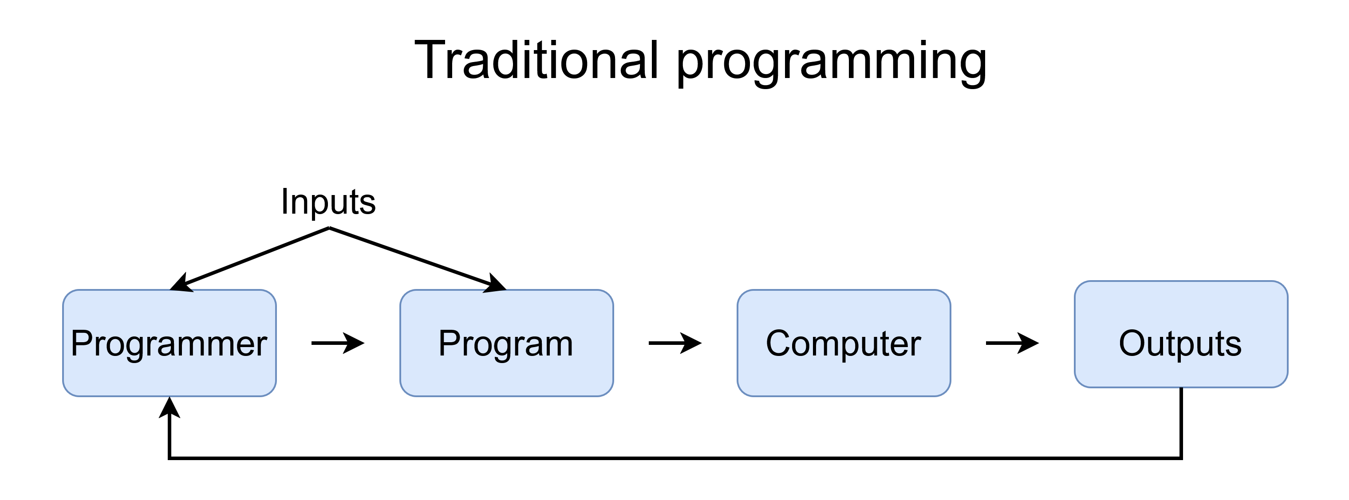
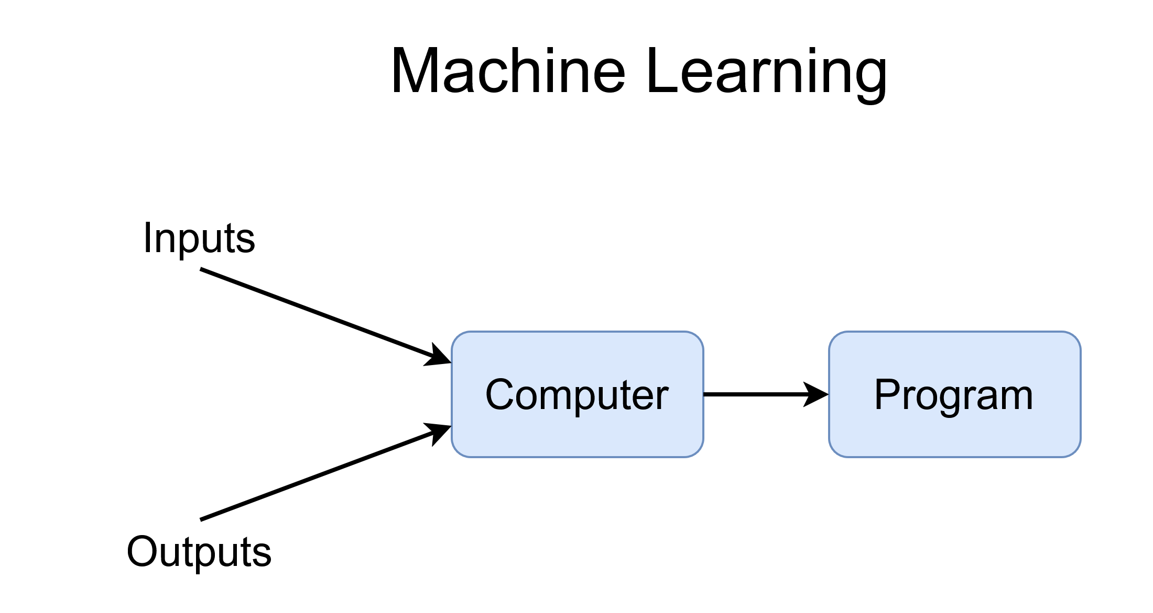
When do we need machine learning ?

Slide 37
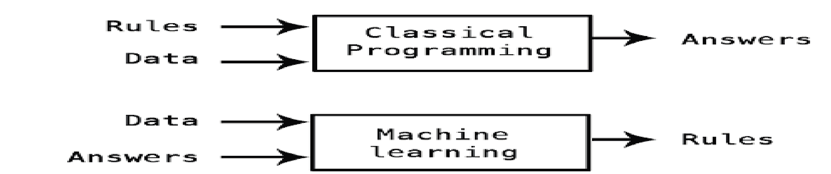

Paradigm shift
Software 1.0
Rule based approach
if speed > 4:
activity = “walking”
elif speed > 7:
activity = “running”
elif speed > 14:
activity = “cycling”
Software 2.0
Machine learning approach
“walking” = [46, 21, 25, 78, 15, 65, 38, 77, 57, 80]
“walking” = [94, 65, 3, 97, 6, 54, 69, 57, 21, 28]
“walking” = [23, 6, 56, 14, 40, 62, 9, 23, 56, 25]
“walking” = [93, 50, 9, 54, 16, 48, 66, 94, 8, 84]
“golfing” = [58, 16, 75, 69, 21, 80, 40, 77, 48, 6]
“golfing” = [25, 73, 26, 66, 82, 74, 54, 6, 23, 23]
“golfing” = [59, 25, 69, 51, 87, 24, 28, 89, 50, 63]
“golfing” = [32, 4, 53, 27, 35, 78, 60, 85, 46, 24]
Notes:
,
,
,
,

Slide 38
Types of machine learning

Slide 39
Types of machine learning
Supervised learning
Unsupervised learning
Reinforcement learning
Algorithms: Linear Regression, Decision Trees, Support Vector Machines, Neural Networks
Algorithms: K-Means, Principal Component Analysis, Neural Networks
Algorithms: Q-Learning, Monte Carlo Tree Search, Neural Networks
Notes:
Describe algorithms; stress that neural networks can be used in all types of machine learning

Slide 40

Types of machine learning
Notes:
Describe applications of machine learning

Slide 41

Types of machine learning
Notes:
Describe applications of machine learning

Slide 42
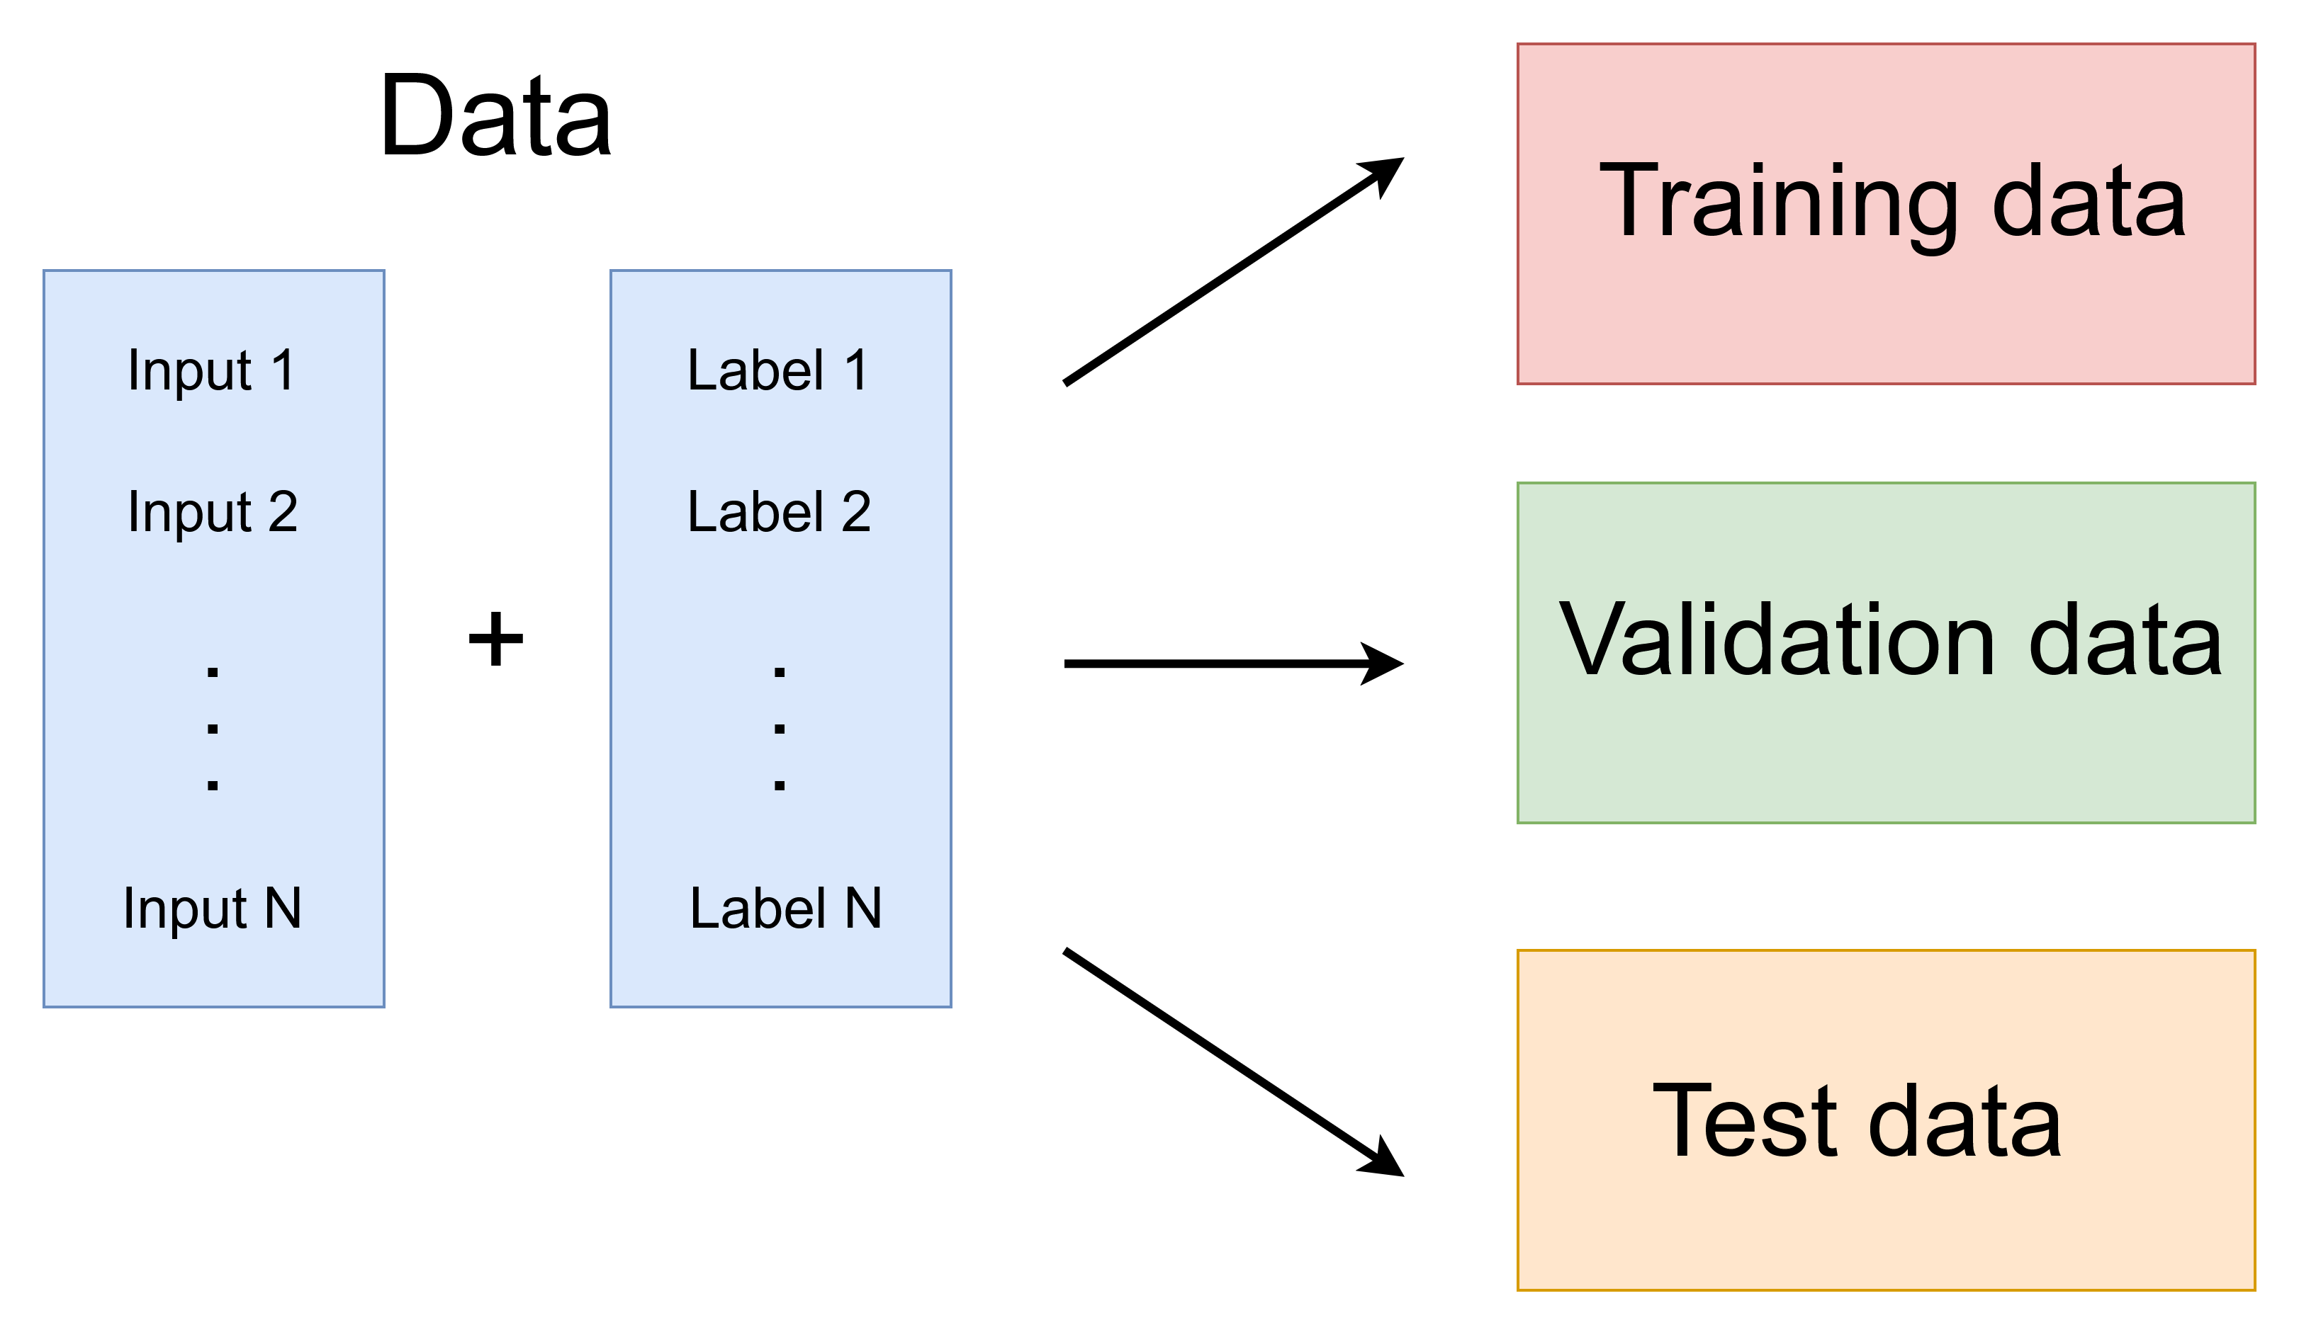
Types of machine learning
Supervised learning
Uses labeled input data (features) for the training process of the model
The input data and respective labels are divided in training, validation and test data
The model is trained with the training data and evaluated using validation and test data
Notes:
Explain training split
Explain overfitting problem

Slide 43
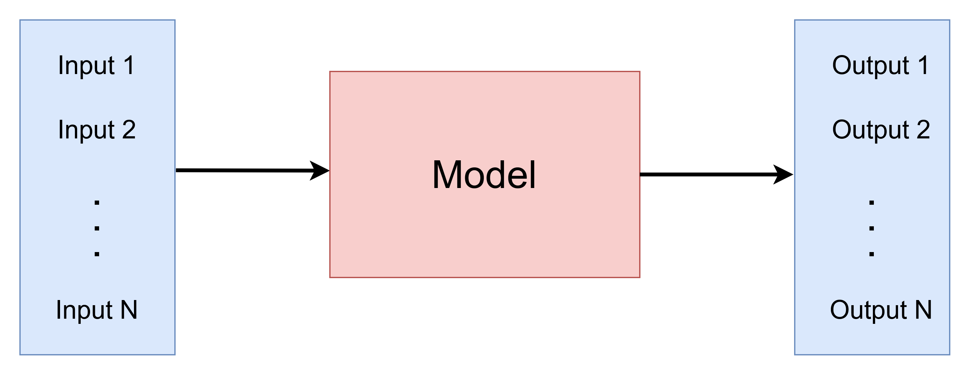
Types of machine learning
Supervised learning
The inputs are passed forward through each layer (Forward Pass) and generate an output
Feature vector
Target vector

Slide 44
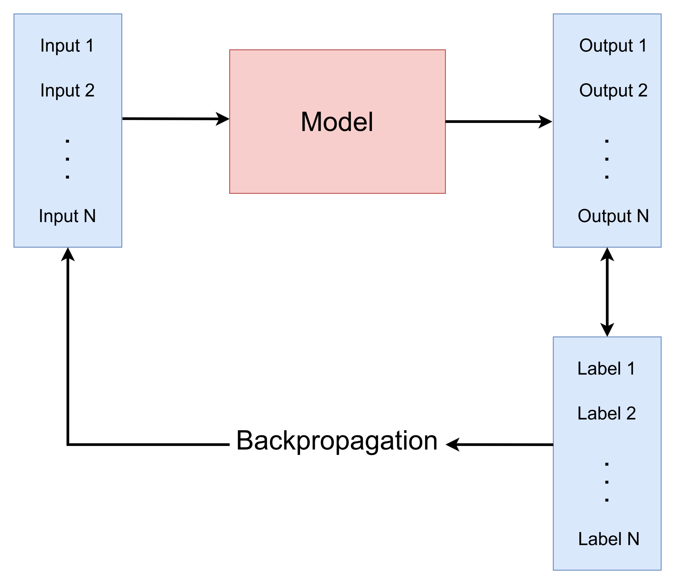
Types of machine learning
Supervised learning
The predictions of the model are compared to the actual labels
Outputs (targets) are adopted to fit the labels using the backpropagation algorithm

Slide 45
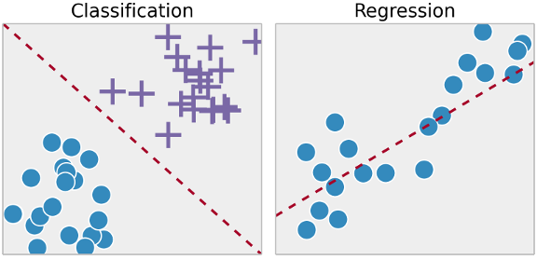
Types of machine learning
Supervised learning
Separating groups of related elements
Predicting the value for a target variable depending on given feature variables

Slide 46
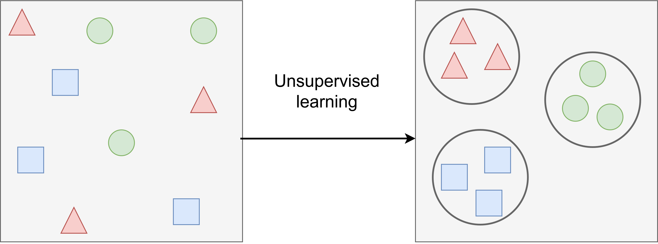
Types of machine learning
Unsupervised learning
Uses unlabeled data to train the model
The model finds patterns in data
Outputs are grouped according to similarity (e.g. Clustering)

Slide 47
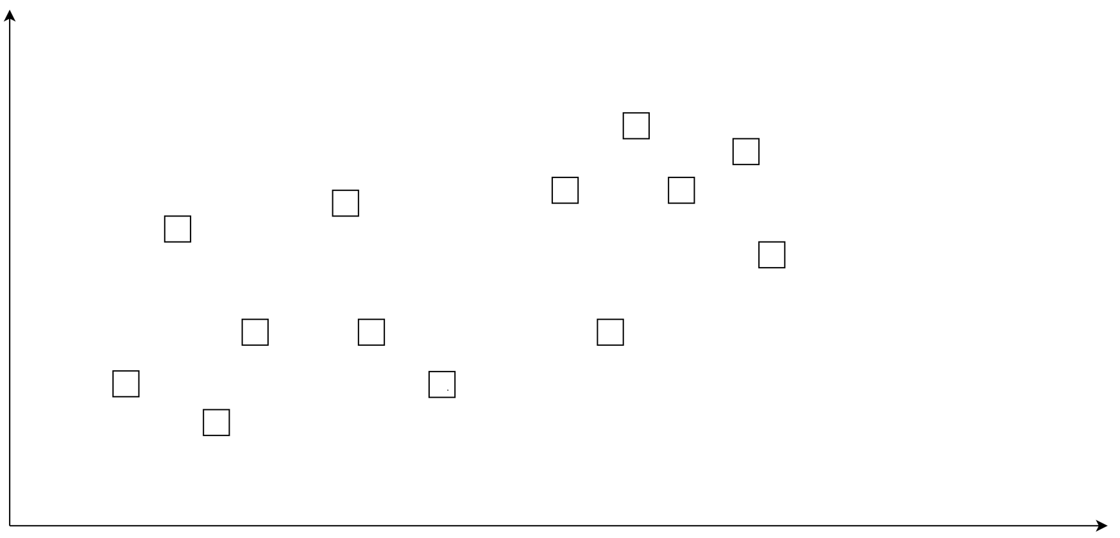
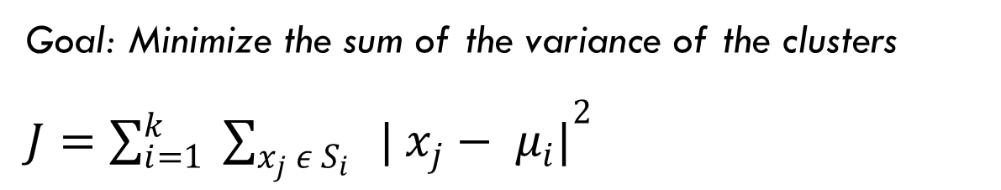
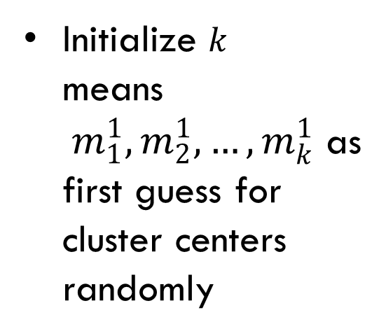
Types of machine learning
Unsupervised learning – K-Means Algorithm
Goal: Minimize the sum of the variance of the clusters
$J={\sum_{i=1}^{k}{ \sum_{x_{j }ε S_{i} }{ | x_{j}− μ_{i}|}}}^{2}$
Initialize $k$ means${ m}_{1}^{1}, m_{2}^{1}, …, m_{k}^{1}$ as first guess for cluster centers randomly
Notes:
Based on the least squares Verfahren
Goal: Minimize the sum of the variance of the clusters J
First initialize at random k – means (hence the name of the algorithm)
t stands for the time step;
In our example we use k = 2; k is a so called hyperparameter of the algorithm, meaning it needs to be set and is not calculated by the algorithm

Slide 48
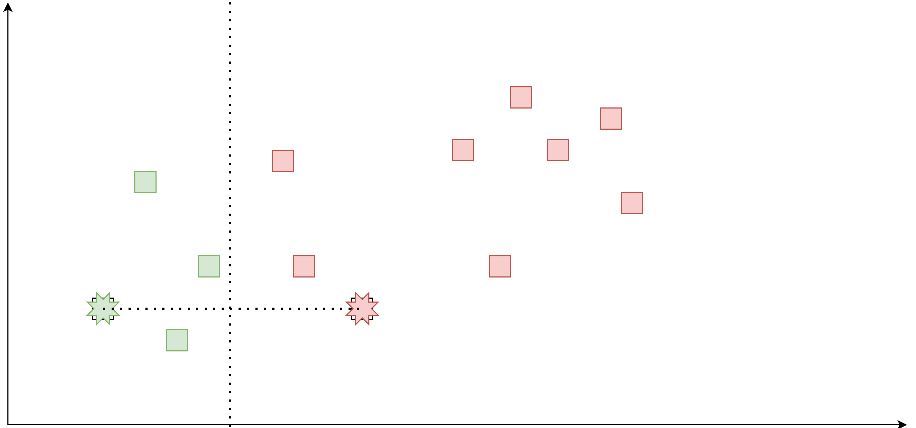
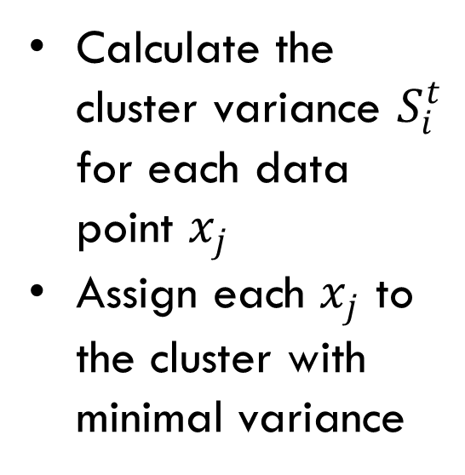
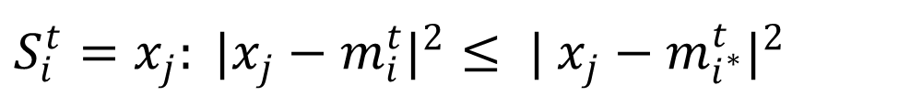
Types of machine learning
Unsupervised learning – K-Means Algorithm
$S_{i}^{t}=x_{j}: |x_{j}−m_{i}^{t}|^{2}≤ | x_{j}−m_{i^{∗}}^{t}|^{2}$
Calculate the cluster variance $S_{i}^{t}$ for each data point $x_{j}$
Assign each $x_{j}$ to the cluster with minimal variance

Slide 49



Types of machine learning
Unsupervised learning – K-Means Algorithm
$m_{i}^{t+1}=\frac{1}{{|S}_{i}^{t}|} \sum_{x_{j}εS_{i}^{t}}{x_{j}}$
Calculate the new cluster centers $m_{i}^{t+1}$ in each iteration
Repeat until the positions of the clusters converge

Slide 50

Types of machine learning
Reinforcement learning
The algorithm (agent) learns through interaction with an environment
These random interactions are either rewarded or penalized according to the resulting state
The agent adopts its strategy (policy) to maximize the rewards

Slide 51

Types of machine learning
Reinforcement learning

Slide 52


What is Deep Learning ?
The idea behind deep learning is to take a large number of examples and successively improve the performance by figuring out how to make the model better.
- George Hinton 1947
The central idea in connectionism is that a large number of simple computational units can achieve intelligent behavior when networked together. - Ian Goodfellow 1987

Slide 53
What is Deep Learning ?
Answer:
Deep learning is a subdomain of Machine learning, which uses neural networks consisting of multiple layers of neurons. These neural networks are trained on input data via the backpropagation algorithm to improve predicitions.

Slide 54

Biological Inspiration
What is Deep Learning ?

Slide 55
Feed-Forward Network – Multi Layered Perceptron

Slide 56
Feed-Forward Network
Dataset
Output/Prediction
Target Output
x₁
x₂
…..
X
_{n}
Error:
-
= 5
Notes:
Let’s take a look at what just happened.
What you are looking at here is another simplified version of a deep neural network. On the bottom we have the inputs, in this case they might represent each pixel value of an image. On the top we have an output that is generated, in this case it could be the probability the image contains a dog. On the left, you can see the output that *should* have been generated…in this case, if the image were a dog, the output *should* have been 100%.
We feed each image through the network to get a prediction which at first will be wrong. In this case, we’re saying it’s 5 units away from what it should have been (maybe it said 95% likelihood of being a dog).
Then, we change the network in some small way. [Next slide]

Slide 57
Feed-Forward Network
Output/Prediction
Target Output
x₁
x₂
…..
X
_{n}
Error:
-
= 15
Notes:
What we change are the coefficients, the multipliers attached to each operation, what we call the ‘weights.’ You can see in this visual, we tried to make this top left “weight” bigger.
What effect did that have on the error?
Exactly. So what do you think we should have done instead?
Exactly. [Next slide]

Slide 58
Feed-Forward Network
Output/Prediction
Target Output
x₁
x₂
…..
X
_{n}
Error:
-
= 2.5
Notes:
Clearly this is the goal. Change each weight by a small amount in the direction that decreases the error. Note that this is one of hundreds of thousands or millions of weights in a neural network.
[Feel free to share partial derivatives here but make sure to let the class know that THEY DON”T CALUCLATE THEM AND YOUR SHARING FOR THE NEAT FACTOR]
We call this method “Stochastic Gradient Descent”.

Slide 59



Training by minimizing the network’s prediction error (supervised learning)
Backpropagation
Algorithm
(Rumelhart et al. 1986)
Non-convex loss function
Notes:
https://devblogs.nvidia.com/inference-next-step-gpu-accelerated-deep-learning/

Slide 60



Difference in Workflow
Examples [ Regression and SVMs ]
Classic Machine Learning [ 1990 : now ]
Hand Designed Features
Model / Mapping
Input
Output
Deep/End-to-End Learning [ 2012 : now ]
Example [ Conv Net ]
Simple Features
Complex Features
Model/ Mapping
Input
Output

Slide 61

Difference in Workflow
Examples [ Regression and SVMs ]
Classic Machine Learning [ 1990 : now ]
Hand Designed Features
Model / Mapping
Input
Output
Challenge: How would you give instructions to differentiate the handwritten digit on the right from other digits to:
A two-year-old child learning numbers OR
A computer using any programming language (including pseudocode)
Answer in discussion section– 3 minutes

Slide 62

HOW IT WORKS
Notes:
Let’s take a look at how deep learning actually works in practice…
Here you can see a very simple model of an untrained neural network. At the top of the model, there is a row or “layer” that has 4 input nodes, and at the bottom there is a layer that has 2 output nodes. Between the input layer and the output layer are a few “hidden” layers with several nodes each. The white lines show which nodes in the input layer share their results with nodes in the first hidden layer, and so on all the way down to the output layer. You may hear the nodes referred to as “perceptrons” or “artificial neurons” since their behavior is inspired by the neurons in the human brain.
A real deep neural network model would have many additional layers between the input layer and the output layer - which is why it’s called “deep” - but a simplified model will work fine for this example.
Just keep in mind that the design of the neural network model is what makes it suitable for a particular task. For example, the best models for image classification are very different from the best models for speech recognition. And the variations can include the number layers, the number of nodes in each layer, the algorithms performed in each node, and the connections between nodes.
So, if the goal is to train a deep neural network to distinguish cats vs. dogs, you would select a neural network model that is designed to be good at image classification.
[next]

Slide 63
HOW IT WORKS
Notes:
The next step is to assemble a collection of representative examples to be used as a training dataset. In this case, several thousand images of both cats and dogs, each with a label indicating whether it belongs to the cat class or the dog class. To ensure the dataset is representative of all the pictures of dogs and cats that exist in the world, the dataset must include a wide range of species, poses, and environments in which dogs and cats may be observed.
Then a deep learning framework is used to feed the training dataset through the network. For each image that is processed through the network, each node in the output layer reports a number that indicates how confident it is that the image is a dog or a cat. In this case there are only two options, so the model only needs two nodes in the output layer – one for dogs and one for cats. When these final outputs are sorted most-confident to least-confident, the result is called a confidence vector. The deep learning framework then looks at the label for the image to determine whether the network chose the correct answer. If it chose correctly, the framework strengthens the weights of the connections that contributed to getting the correct answer. And vice-versa, if it chose incorrectly, the framework reduces the weights of the connections that contributed to getting the wrong answer.
After processing the entire training dataset once, the neural network will generally have enough experience to choose the correct answer a little more than half of the time (so better than a random coin toss) but it will require several additional rounds or “epochs” of processing the entire training dataset to achieve higher levels of accuracy.
It’s worth noting that there are readily available models for image classification, object recognition, image segmentation and several other tasks – but it is often necessary to modify these models to achieve high levels of accuracy for a particular dataset. So the computation required to train one version of the model is multiplied by the number of model variations that need to be evaluated. All of this processing requires a tremendous amount of computation, much of which can be performed in parallel, which makes deep learning an ideal workload for GPUs to accelerate.
There are also many deep learning frameworks to choose from, each with its own set of strengths, programming language interfaces, etc. but they’re all GPU-accelerated using cuDNN and other libraries in the NVIDIA Deep Learning SDK. You can learn more about all the deep learning frameworks and the NVIDIA Deep Learning SDK on our developer web site at developer.nvidia.com.
[next]

Slide 64
HOW IT WORKS
Notes:
So, now that the model has been trained on a large representative dataset, it’s very good at distinguishing between cats vs. dogs. But if you showed it a picture of a racoon it would be very confused since it has no experience with racoons, and would probably report a low confidence number for both dog and cat.
If you need the ability to classify racoons as well as dogs and cats, you would simply add a third node to the output layer of the model, expand the training dataset to include thousands of representative images of racoons, and use the deep learning framework to re-train the network.
There’s no need to manually write a racoon classifier algorithm and figure out how to integrate it into your application, just re-train the deep neural network with your new data set.

Slide 65
HOW IT WORKS
Notes:
The next step is to assemble a collection of representative examples to be used as a training dataset. In this case, several thousand images of both cats and dogs, each with a label indicating whether it belongs to the cat class or the dog class. To ensure the dataset is representative of all the pictures of dogs and cats that exist in the world, the dataset must include a wide range of species, poses, and environments in which dogs and cats may be observed.
Then a deep learning framework is used to feed the training dataset through the network. For each image that is processed through the network, each node in the output layer reports a number that indicates how confident it is that the image is a dog or a cat. In this case there are only two options, so the model only needs two nodes in the output layer – one for dogs and one for cats. When these final outputs are sorted most-confident to least-confident, the result is called a confidence vector. The deep learning framework then looks at the label for the image to determine whether the network chose the correct answer. If it chose correctly, the framework strengthens the weights of the connections that contributed to getting the correct answer. And vice-versa, if it chose incorrectly, the framework reduces the weights of the connections that contributed to getting the wrong answer.
After processing the entire training dataset once, the neural network will generally have enough experience to choose the correct answer a little more than half of the time (so better than a random coin toss) but it will require several additional rounds or “epochs” of processing the entire training dataset to achieve higher levels of accuracy.
It’s worth noting that there are readily available models for image classification, object recognition, image segmentation and several other tasks – but it is often necessary to modify these models to achieve high levels of accuracy for a particular dataset. So the computation required to train one version of the model is multiplied by the number of model variations that need to be evaluated. All of this processing requires a tremendous amount of computation, much of which can be performed in parallel, which makes deep learning an ideal workload for GPUs to accelerate.
There are also many deep learning frameworks to choose from, each with its own set of strengths, programming language interfaces, etc. but they’re all GPU-accelerated using cuDNN and other libraries in the NVIDIA Deep Learning SDK. You can learn more about all the deep learning frameworks and the NVIDIA Deep Learning SDK on our developer web site at developer.nvidia.com.
So, now that the model has been trained on a large representative dataset, it’s very good at distinguishing between cats vs. dogs. But if you showed it a picture of a racoon it would be very confused since it has no experience with racoons, and would probably report a low confidence number for both dog and cat.
If you need the ability to classify racoons as well as dogs and cats, you would simply add a third node to the output layer of the model, expand the training dataset to include thousands of representative images of racoons, and use the deep learning framework to re-train the network.
There’s no need to manually write a racoon classifier algorithm and figure out how to integrate it into your application, just re-train the deep neural network with your new data set.

Slide 66






Democratization of AI by open source deep learning frameworks
Notes:
https://devblogs.nvidia.com/inference-next-step-gpu-accelerated-deep-learning/

Slide 67
Types of Artificial neural networks
Neural Networks
Fully Connected
Recurrent
Convolutional
Generative Adversarial
Transformers

Slide 68
Computervision –
How did computers learn to see?

Slide 69

Computervision
Increasing complexity

Slide 70

Inputs and Outputs
Computervision
Notes:
What kind of inputs are there in computervision?

Slide 71

Inputs and Outputs
Computervision

Slide 72
CONVOLUTION
Computervision
Center element of the kernel is placed over the source pixel. The source pixel is then replaced with a weighted sum of itself and nearby pixels.
0
0
0
0
0
0
0
1
0
0
1
1
1
0
1
2
0
1
2
0
1
2
2
1
0
2
2
1
0
0
1
2
4
0
Source Pixel
0
1
2
1
0
0
0
0
1
0
0
0
1
1
1
0
-4
0
1
0
0
-8
0
1
1
0
0
Convolution kernel (a.k.a. filter)
New pixel value (destination pixel)
Notes:
In Deep Learning, there are many different ways to construction a layer. One of the most important techniques is a convolutional neural network. A convolution neural network applies a small kernel to a patch of the input data. Applying kernels like this are much less computationally intensive than a fully connected network.
Kernel = filter = matrix (typically small)
Dot production calculation is performed between convolution (filter) and source pixels
Result is stored in an activation map
This convolution example is shown here in 2D but can be done in any amount of dimensions.
We have a convolution kernel in the center, to transform the source image.
At each location we do a pair wise multiplication of the kernel and the source values and sum these together to get the destination value.
Source Left: http://www.biomachina.org/courses/structures/01.html
Source Right: http://www.westworld.be

Slide 73


Computervision
CONVOLUTION
Source: Vibhor Nigam
Source: Arden Dertat

Slide 74


CONVOLUTION
Computervision

Slide 75

Convolutional Neural Network - Alex Net
Created by Alexander Krizhevsky, Ilya Sutskever and Geoffrey Hinton
Winner of the ImageNet ILSVRC Challenge 2012
Applied Convolutional Layers without Pooling
Dropout Regularization
Data Augmentation
Notes:
This is an abstracted view of a network like AlexNet. It’s specifically designed to learn to classify images. It can learn to recognize handwritten digits, whale faces, or tumors.
The first 5 layers are “convolutional layers.” There is an introduction to the math of a “convolution” in the lab, but at a high-level, each layer learns higher and higher level features.
The last three are “fully-connected layers.” These do traditional matrix multiplication. These are the most generalized learning layers used in deep learning, meaning they are not designed to learn something specific, but continue learning and change the shape of data to generate a desired output step.
One constraint of “fully-connected layers” is that they require specific input sizes. The next section of the lab will guide you through the replacement of these layers with convolutional layers, creating a (Fully Convolutional Network) that can take as input images of any size!
This task is just one of many that you could try to change the behavior of your network. The challenge in this section is in rearranging a network where data still flows.
In this example of facial identification, the network has several hidden layers.
The first hidden layers detect low level features, often edges or circles
As data move through the network, mid-level features are extracted from subsequent layers. The mid-level features can be eyes, mouths or noses
High-level features are composites of different faces that have been passed through the network
Networks like this can have the following properties
Be trained with tens or hundreds of millions of images
The network can consists of tens to hundreds of layers with millions or even billions of weights
Training large networks can often days or weeks.

Slide 76


Convolutional Neural Network - Alex Net
Notes:
This is an abstracted view of a network like AlexNet. It’s specifically designed to learn to classify images. It can learn to recognize handwritten digits, whale faces, or tumors.
The first 5 layers are “convolutional layers.” There is an introduction to the math of a “convolution” in the lab, but at a high-level, each layer learns higher and higher level features.
The last three are “fully-connected layers.” These do traditional matrix multiplication. These are the most generalized learning layers used in deep learning, meaning they are not designed to learn something specific, but continue learning and change the shape of data to generate a desired output step.
One constraint of “fully-connected layers” is that they require specific input sizes. The next section of the lab will guide you through the replacement of these layers with convolutional layers, creating a (Fully Convolutional Network) that can take as input images of any size!
This task is just one of many that you could try to change the behavior of your network. The challenge in this section is in rearranging a network where data still flows.
In this example of facial identification, the network has several hidden layers.
The first hidden layers detect low level features, often edges or circles
As data move through the network, mid-level features are extracted from subsequent layers. The mid-level features can be eyes, mouths or noses
High-level features are composites of different faces that have been passed through the network
Networks like this can have the following properties
Be trained with tens or hundreds of millions of images
The network can consists of tens to hundreds of layers with millions or even billions of weights
Training large networks can often days or weeks.

Slide 77




Convolutional Neural Network - Alex Net
Raw data
Low-level features
Mid-level features
High-level features
Application components:
Task objective
Identify 1000 different categories
Network architecture
5 CNN
3 Pooling layers
3 Dense layers
60 Mio parameters
Input
Result
Notes:
This is an abstracted view of a network like AlexNet. It’s specifically designed to learn to classify images. It can learn to recognize handwritten digits, whale faces, or tumors.
The first 5 layers are “convolutional layers.” There is an introduction to the math of a “convolution” in the lab, but at a high-level, each layer learns higher and higher level features.
The last three are “fully-connected layers.” These do traditional matrix multiplication. These are the most generalized learning layers used in deep learning, meaning they are not designed to learn something specific, but continue learning and change the shape of data to generate a desired output step.
One constraint of “fully-connected layers” is that they require specific input sizes. The next section of the lab will guide you through the replacement of these layers with convolutional layers, creating a (Fully Convolutional Network) that can take as input images of any size!
This task is just one of many that you could try to change the behavior of your network. The challenge in this section is in rearranging a network where data still flows.
In this example of facial identification, the network has several hidden layers.
The first hidden layers detect low level features, often edges or circles
As data move through the network, mid-level features are extracted from subsequent layers. The mid-level features can be eyes, mouths or noses
High-level features are composites of different faces that have been passed through the network
Networks like this can have the following properties
Be trained with tens or hundreds of millions of images
The network can consists of tens to hundreds of layers with millions or even billions of weights
Training large networks can often days or weeks.

Slide 78










Convolutional Neural Network - Alex Net

